Slide 1
Sports Products Sales Performance Analysis using SQL
A comprehensive SQL-based exploration of sales, profits, and regional trends
Name: Debdatta Mukherjee
Date: October 2025

Slide 2
Project Objective
Goal: To analyze sports product sales data to identify patterns in revenue, profit, regional growth, and retailer performance using SQL.
Key Objectives:
  Measure total revenue & profitability
  Compare regional and product performance
  Identify top retailers and sales methods

Slide 3
Dataset Overview
Dataset: 9,644 records × 13 columns
Source: “Sports Products Sales Analysis Dataset”
Column | Description
Retailer | Seller name
Invoice Date | Date of sale
Region / State / City | Geographical attributes
Product | Product type
Price per Unit | Unit price
Units Sold | Quantity sold
Total Sales | Total revenue
Operating Profit | Profit
Operating Margin | Profit ratio
Sales Method | Online / Outlet / In-store

Slide 4
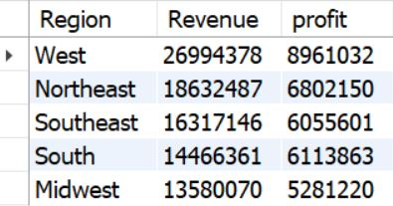
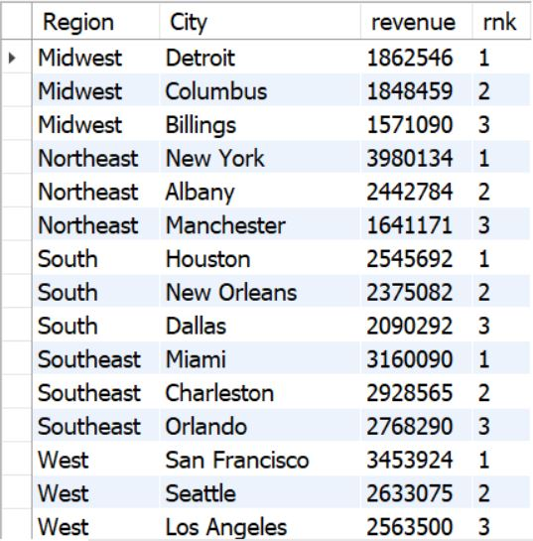
Regional Performance
Total revenue and profit generated by each region.
Top 3 cities contributing most to revenue in each region.
Identify most profitable product in each region.
Men’s street footwear ranked 1 across Midwest, Northeast, Southeast, West & Women’s apparel ranked 1 in South.

Slide 5
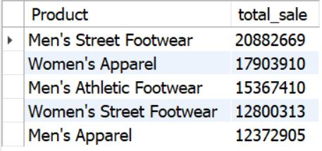
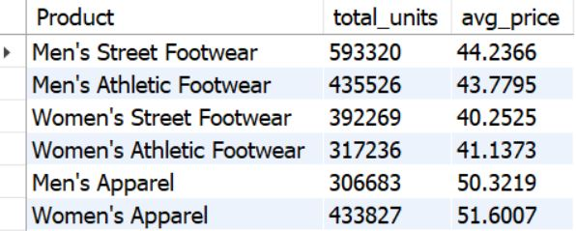
Product Insights
Top 5 best-selling products by total sales.
Total units sold and average price per unit for each product.
Which product category gives the highest average profit margin?
Men’s street footwear gives the Highest average profit margin of 44%

Slide 6
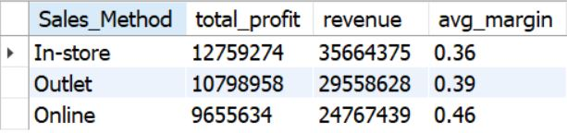
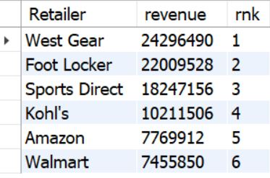
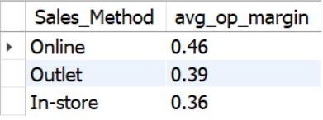
Retailer & Sales Channel
Find which sales method (Outlet/Online/Store) performs best in terms of profit.
Rank retailers based on total revenue.
Average operating margin per sales method.

Slide 7
Business Recommendations
Expand outlet network in top-performing regions
Focus on women’s footwear for high-margin returns
Optimize pricing strategy to maintain volume
Introduce loyalty programs for high-revenue cities

Slide 8
Conclusion
Summary:
  SQL effectively revealed patterns in sales & profit.
  Key insights support data-driven decisions for product & region strategy.

